Slide 1
The National Disability Insurance Scheme (NDIS):
How is Mental Health Faring?
Featured Symposium 28 August 2014 TheMHS Conference
Perth, Western Australia

Slide 2





Symposium Participants
Chair/facilitator: Pamela Rutledge – CEO, RichmondPRA
Eddie Bartnik (National Disability Insurance Agency)
  Bringing the health and disability sectors together to maximise the NDIS opportunity
Tina Smith (Mental Health Coordinating Council)
  Experiences and lessons from the NSW Hunter pilot site
Rod Astbury (WA Association for Mental Health)
  Community sector perspectives on WA experiences and lessons from preparing and setting up two pilot sites
Liz Ruck (Mental Health Australia)
  Mental health sector capacity building for the NDIS

Slide 3
Symposium learning objectives
Conference delegates attending this session can expect to leave more informed about opportunities and challenges presenting through the NDIS implementation journey from a mental health and psychosocial disability perspective.
This topic is relevant to the mental health sector in that at full roll-out the NDIS is expected to deliver services to 57 thousand Australians with high levels of psychosocial disability secondary to mental ill health.
… how this may be achieved and how is mental health faring?

Slide 4

Bringing the health and disability sectors together to maximise the NDIS opportunity
Eddie Bartnik
Strategic Advisor
National Disability Insurance Agency

Slide 5
National Disability Insurance Scheme
NDIS: How is mental health faring?
Eddie Bartnik
Strategic Advisor
National Disability Insurance Agency (NDIA)
TheMHS Conference, Perth WA 28/8/14

Slide 6
Outline
Some introductory comments: great opportunity, complex environment of reforms but flows on from recovery framework, bringing mental health and disability sectors together so partnerships critical
Three pillars underpinning NDIS design
Access for people with a psychosocial disability in the NDIS
Some key trial site issues emerging around psychosocial disability
Some priorities moving forward in full scheme design and transition

Slide 7
Three key pillars underpin NDIS design
Insurance Approach
Supports economic and social participation Mobilises funding for early intervention Estimates and manages resource allocation based on managing long term costs across the life-course of individuals Shares the cost of disability across the community
Choice and Control
Participants determine how much control they want over management of their funding, supports and providers Scheme gives effect to certain obligations under the Convention on the Rights of Persons with Disabilities - including respect for their worth, dignity and to live free from abuse, neglect and exploitation
Community and Mainstream
People are supported to access and coordinate community and funded supports The scheme will not duplicate or replace mainstream services Effective interface with mainstream and community supports is central to the sustainability of the Scheme

Slide 8
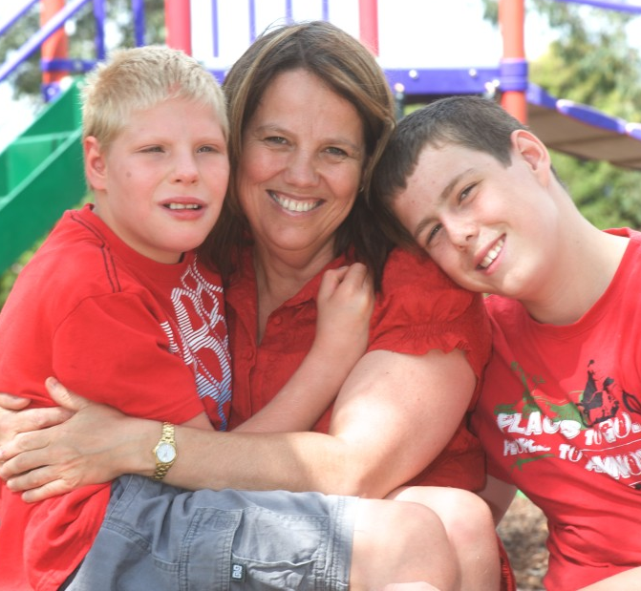
Disability requirements
    Accessing assistance from the scheme requires that a person must:
    Have permanent disability (“person has a disability that is attributable to one or more impairments attributable to a psychiatric condition….are, or are likely to be permanent”)
    The disability must have a significant impact on day to day life and on the person’s ability to participate in the community (“severity of impact on functioning may fluctuate and may improve, determined when the impairment is fully treated and stabilised – residual and LT)”)
    The person will (“likely”) need supports for the rest of their life

Slide 9
Some key issues around psychosocial disability
Continue to learn from trials and engagement
Eligibility and access – notions of permanent/likely to be permanent, recovery, list of conditions, support from other people on most days, early intervention
Holistic support and integration of clinical and psychosocial
The important involvement of families, carers, friends and informal supports in peoples lives
Readiness of all in the sector to imagine, plan and implement more personalised supports to achieve outcomes
Continuity of support and the interfaces between Tier 2 and 3 of the NDIS and mainstream mental health services – where people not eligible for NDIS
Support clusters and pricing, organisational capability
Psychosocial disability often later in phasing so learnings are just emerging

Slide 10
Some priorities moving forward
Working with Mental Health Council of Australia and the NDIS Sector Development Fund
Scheme design and disability estimates, Tier 2 and mainstream, Local Area Coordination
National Roundtable and Paul O’Halloran consultancy on psychosocial disability and holistic support
Launch site and state/territory roundtables and conferences on psychosocial disability and scheme implementation
Data and open learning cycle from launch sites: eg including some examples to share understandings and practice, access process , support clusters and pricing
Engagement of clinicians and state and territory mental health systems
Right combination of consultative processes at local, state/territory and national levels and improved guidance around psychosocial disability: Eddie Bartnik is lead Adviser for NDIA development of a strategic work plan
Start of an exciting long term journey: importance of vision, values and partnerships – nearly 60,000 people with psychosocial disability and their families/carers to benefit.

Slide 11
Questions?

Slide 12

Experiences and lessons from the NSW Hunter pilot site
Tina Smith
Senior Policy Officer/Sector Development
(NDIS Mental Health Analyst)
Mental Health Coordinating Council

Slide 13


Mental Health Coordinating Council (MHCC)
Peak body representing NSW non-government/ community managed organisations (NGOs/CMOs) providing services to people affected by mental health issues in NSW
Our Vision
People with lived experience are the drivers of positive change in all mental health services and mental health reforms.
Our Purpose
To build the capacity and ability of community organisations to support people on their recovery journeys.

Slide 14



MHCC Partnership with the NSW Mental Health Commission
NDIS Year 1 partnership objectives are to better understand ………
How will psychosocial disability (PSD) be understood and included under the NDIS?
The wider NDIS and health services interface (eg, physical health, substance use)
People with co-existing difficulties (eg, intellectual, physical, sensory and other disability)
The suitability of the assessment tool/s
Contribute to the national discourse regarding the situating of psychosocial disability within the NDIS
… what is the NDIS and how it will affect people living with mental health concerns?

Slide 15

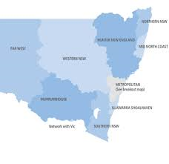
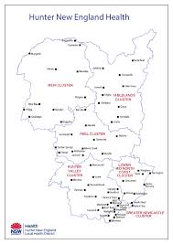
NSW Hunter NDIS Trial Site Activity
10K people in Newcastle, Lake Macquarie and Maitland LGAs (1,300 with high levels of psychosocial disability?)
  2013/14: 3K people Newcastle LGA
  2014/15: 5K people Lake Macquarie LGA
  2015/16: 2K people Maitland LGA
Trial commenced 1July 2013 and has been the only Year 1 launch site with high levels of mental health (MH)/psychosocial disability (PSD) activity

Slide 16

1. How will PSD be understood and included under the NDIS?
… in terms of:
Access and eligibility
Existing mental health community sector and public mental health programs
Equity, monitoring and safeguard mechanisms, and
Workforce appropriateness.
… organisational readiness?

Slide 17
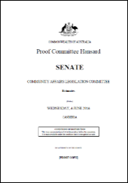
Access and eligibility
At the March Hunter NDIS & MH ‘Community of Practice’ (COP) Forum:
NDIA reported 89 clients with ‘primary’ PSD and 75 now had plans.
HNEMHS reported 63 referrals of people to NDIA from hospitals (19 people accepted) and community team caseloads being audited.
At the end of March, 531 people with PSD had accessed the NDIS nationally:
298 primary PSD (and 93 with approved plans)
233 secondary PSD
This is less than 1% of the target of 57K people with PSD intended to access NDIS support by the end of the 3 year trial:
13% of 430K people nationally
19K people in NSW, and
1,300 people in the NSW Hunter trial site.
“It’s not about numbers … it’s about people!” (what do you think?)
LESSON: It’s about both people with PSD accessing the NDIS and the numbers of them accessing.

Slide 18

2. The wider NDIS and health services interface
… including but not limited to physical health and substance abuse (ie, health and disability/social care interface)
2013 implementation structures
Fortnightly NDIA/HNELHD NDIS implementation meeting
17 October FaCS/NSW Health ‘Pathways’ Meeting
2014 implementation structures
Maturation of operational and governance structures
NDIS Operational Working Group (NDIA, FaCS, HNELHD)
Physical health SMEG
Child and adolescent SMEG
MH SMEG (MHCC invited every 2nd month)
LESSON: It’s about people with complex health and social needs and consumer & carer representation is critical to getting it right!

Slide 19
3. People with co-existing difficulties
… including but not limited to intellectual, physical, sensory and other disability)
Improved access to specialist MH treatment services for all (including prevention, promotion and early intervention services)
How to deliver coordinated & integrated health and social services
What is a clinical and non-clinical service or ‘intervention’?
Lesson: We need to better understand health & disability role delineations as currently articulated in the ‘in-principle’ agreements (and include local level variations).

Slide 20
4. The suitability of the assessment tool/s
No public acknowledgment about the assessment and care planning tools being used by the NDIA. However …
NDIA – modified Support Intensity Scale (SIS)
Partners in Recovery – Modified CANSAS
PWC recommendation for NDIS to use WHODAS 2 (designed to bring health and disability/social care together)
LESSON: Assessment and care planning tools and processes need to be consistent with what is known to be good practice in recovery oriented and trauma informed service delivery

Slide 21
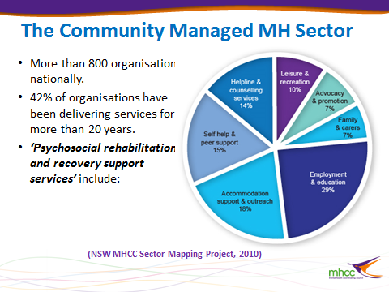

5. Contribute to the national discourse
Ongoing collaboration with a range of national stakeholders
MHCC MOU with the National Disability Service (NDS)
NSW representation to the MHA NDIS Capacity Building Project
Project Advisory Group
Tina Smith/MHCC
Working Groups (5)
Scheme design and administrative arrangements
Tully Rosen/MHCC, Mark Cliff/Richmond PRA – Hunter & Sally Regan/PIR (Hunter Medicare Local)
Assessment and eligibility
Rob Ramjan/SFNSW & Nicola O’Brien/Neami National (Hunter)
Monitoring, evaluation and service quality
Tully Rosen/MHCC, Janelle Heatley/Aftercare (Hunter) & Mark McCormack/SFNSW (consumer representative)
Supported decision making and diverse groups
Kieran Condell/SFNSW
Organisational readiness and workforce
Tina Smith/MHCC (Chair)
LESSON: Our learning is going to be continuing for a long time and so how do we best maximise this?

Slide 22


NSW Perspective on NDIS …..
The 10:30 AM Friday 29/8 paper will address:
Activities undertaken through the MHCC NDIS ‘MH analysis’ partnership with the NSW MH Commission
Hunter NDIS & MH ‘Community of Practice’ (COP) Forum
Consumer & carer representation and participation in NDIS implementation & evaluation
Establishment of NDIA/HNEMHS MH Subject Matter Reference Group
Engagement with MHCA NDIS Capacity Building Project
http://www.mhcc.org.au/policy-advocacy-reform/influence-and-reform/ndis-and-mental-healthpsychosocial-disability.aspx
… or …. : MHCC NDIS

Slide 23
WA experiences and lessons from preparing and setting up two pilot sites
Rod Astbury
Executive Director
WA Association for Mental Health

Slide 24
Mental health sector capacity building for the NDIS
Liz Ruck
Senior Policy Advisor
(NDIS Capacity Building Project, Project Manager)
Mental Health Australia

Slide 25
NDIS: how is mental health faring?
A national perspective

Slide 26
Key Concepts
              NDIS is an insurance model not a service system
              Mental illness ≠ psychosocial disability
              1,2,3 – support is tiered
              The scheme is in transition

Slide 27
Where are we at?
              MHA ❤ NDIS
              Opportunities
              Many unanswered questions
              Limited trial site experiences
              Fundamental policy concerns
              Major implementation challenges

Slide 28
Opportunities = work to do
              Implementation
                1st order priorities
                2nd order prioities
              Policy

Slide 29
Implementation challenges
              First order priorities
              Understanding lessons from trial site experiences
              Getting the assessment process right
              Maximising the input of carers and other trusted people

Slide 30
Implementation challenges
              First order priorities contd.
              Involving non-government stakeholders in rollout
              Describing and defining psychosocial disability services
              Pricing structures

Slide 31
Implementation challenges
              Second order priorities
              Pathways, engagement and outreach
              Building tomorrow’s workforce
              Mental health skills and experience in NDIA

Slide 32
Policy Challenges
              Tension/conflict between ‘permanency of impairment’ and recovery principles
              Designing Tier 2
              Commonwealth state/agreements
              Role of NDIS vs other service systems

Slide 33
Emerging Priorities
              Wish list
              Mapping in-scope programs and services in each state
              Defining Tier 2 services and quantifying the economic benefits

Slide 34
MHA Capacity Building Priorities
              More support for consumers and carers
              Working with service providers
              Supported decision making
              Scoping workforce development needs

Slide 35
MHA Mental Health Capacity Building
              Online information hub www.mhca.org.au
              Regular e-bulletins – please register
              Contact: Liz Ruck lizruck@mha.org

Slide 36
NDIS – How is MH Faring?
Panellists reflections on presentations
Audience questions?

Slide 37
Possible questions for panellists
What activities is the NDIS undertaking to ensure their ability to respond flexibly to the needs of people with mental illness/psychosocial disability?
What is known about eligibility for NDIS (who’s in and who’s out)?
What tools and processes are being used for assessment and care/support planning with people with psychosocial disability?
What partnerships are required to ensure coordinated support for people?
How ready is your organisation and its workforce for the NDIS?
What will happen for people who are not eligible for NDIS?

Slide 38
Thank you for your participation:
Eddie Bartnick: Eddie.BARTNIK@ndis.gov.au
Tina Smith: tina@mhcc.org.au
Rod Astbury: RAstbury@waamh.org.au
Liz Ruck: liz@mhca.org.au

